Slide 1
Unit-5
Cont…

Slide 2
Practical – Exception Handling
Exception Handler is a code block in memory that will attempt to resolve the current exception condition
To handle very common and repetitive exception conditions the oracle engine used Named Exception Handlers
Oracle has 15 to 20 Named Exception and more than 20,000 numbered exception
An exception is an error which disrupts the normal flow of program instructions. PL/SQL provides us the exception block which raises the exception thus helping the programmer to find out the fault and resolve it.

Slide 3
There are two types of exceptions defined in PL/SQL
User defined exception.
System defined exceptions.
Named system exceptions.
Unnamed system exceptions.
Syntax to write an exception
WHEN exception THEN
statement;

Slide 4
BEGIN executable command(s);
EXCEPTION WHEN exception1 THEN statement1; WHEN exception2 THEN statement2; [WHEN others THEN] /* default exception handling code */
END;
When other keyword should be used only at the end of the exception handling block as no exception handling part present later will get executed as the control will exit from the block after executing the WHEN OTHERS.

Slide 5
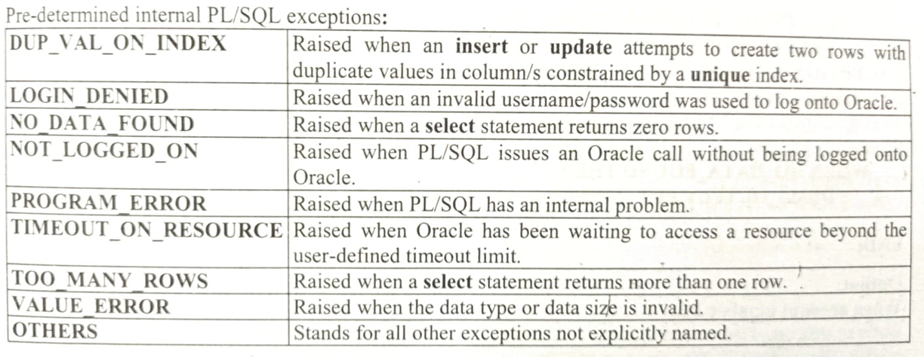
Named Exception Handlers

Slide 6
Example
DECLARE
c_id customers.id%type := 8;
c_name customerS.Name%type;
c_addr customers.address%type;
BEGIN
SELECT name, address INTO c_name, c_addr
FROM customers
WHERE id = c_id;
DBMS_OUTPUT.PUT_LINE ('Name: '|| c_name);
DBMS_OUTPUT.PUT_LINE ('Address: ' || c_addr);
EXCEPTION
WHEN no_data_found THEN
dbms_output.put_line('No such customer!');
WHEN others THEN
dbms_output.put_line('Error!');
END;
/

Slide 7
Unnamed system exceptions:
Oracle doesn’t provide name for some system exceptions called unnamed system exceptions.
These exceptions don’t occur frequently.
These exceptions have two parts code and an associated message.
The way to handle to these exceptions is to assign name to them using Pragma EXCEPTION_INIT
Syntax:
PRAGMA EXCEPTION_INIT(exception_name, -error_number);
error_number are pre-defined and have negative integer range from -20000 to -20999.

Slide 8
DECLARE
exp exception;
pragma exception_init (exp, -20015);
n int:=10;
BEGIN
FOR i IN 1..n LOOP
dbms_output.put_line(i*i);
IF i*i=36 THEN
RAISE exp;
END IF;
END LOOP;
EXCEPTION
WHEN exp THEN
dbms_output.put_line('Welcome to GeeksforGeeks');
END;

Slide 9
User Defined Exception
PL/SQL allows you to define your own exceptions according to the need of your program.
A user-defined exception must be declared and then raised explicitly, using either a RAISE statement or the procedure
DBMS_STANDARD.RAISE_APPLICATION_ERROR.
Syntax:
DECLARE
exception_name EXCEPTION;
BEGIN
IF condition THEN
RAISE exception_name;
END IF;
EXCEPTION
WHEN exception_name THEN
statement;
END;

Slide 10
Example
DECLARE
c_id customers.id%type := &cc_id;
c_name customerS.Name%type;
c_addr customers.address%type;
-- user defined exception
ex_invalid_id EXCEPTION;
BEGIN
IF c_id <= 0 THEN
RAISE ex_invalid_id;
ELSE
SELECT name, address INTO c_name, c_addr
FROM customers
WHERE id = c_id;
DBMS_OUTPUT.PUT_LINE ('Name: '|| c_name);
DBMS_OUTPUT.PUT_LINE ('Address: ' || c_addr);
END IF;
EXCEPTION
WHEN ex_invalid_id THEN
dbms_output.put_line('ID must be greater than zero!');
WHEN no_data_found THEN
dbms_output.put_line('No such customer!');
WHEN others THEN
dbms_output.put_line('Error!');
END;
/

